Slide 1
How Businesses Can Take Advantage of U.S. EPA’s Audit Policy
Dave Scriven-Young
Peckar & Abramson, P.C.
www.pecklaw.com
www.illinoisenvironmentallaw.com

Slide 2
OUTLINE
What is an environmental audit?
(2) How can businesses take advantage of U.S. EPA’s Audit Policy?
(3) How can businesses take advantage of Illinois’ Environmental Audit Law?

Slide 3
What Is An Environmental Audit?

Slide 4
Environmental Auditing is the process of determining whether operations and practices are in compliance with regulatory requirements, company policies and procedures, and accepted standards.
It is a systematic, objective evaluation of facility activities for a finite review period designed to:

Slide 5
• Verify compliance with environmental regulations, internal policies, and accepted practices.
• Evaluate the effectiveness of environmental management systems in place, and
• Identify and assess any reasonably foreseeable risks associated with hazardous conditions attributable to company operations and prevent or mitigate such risks.

Slide 6
What are the Goals of an Environmental Audit?
Identify and assess environmental risks
Optimize Resources
Provide assurance to senior management
Increase environmental awareness throughout the company
Identify and document facility compliance status
Improve overall environmental performance at facilities
Assist facility management
Notes:
Audits note shortcomings that exist at facilities, but also acknowledge areas of great performance. Evaluate patterns of deficiencies developing over time.
(2) Regularly scheduled audits provide an incentive for permanent resolution of environmental issues.
(3) Aid management to identify compliance issues and solutions, assist in employee training needs.
(4) Audits assess risk of hazards
(5) Audits may result in consolidation of resources and technologies resulting in more efficient and cost effective management strategies
(6) Provide management with evidence that the environmental issues are being effectively managed and company’s liabilities are minimized.
(7) Audits demonstrate management’s commitment to environmental compliance and increase environmental awareness facility-wide.

Slide 7
What Help Does A Company Need To Conduct An Environmental Audit?

Slide 8
What Help Does A Company Need To Conduct An Environmental Audit?
It depends on the company . . .

Slide 9
What Help Does A Company Need To Conduct An Environmental Audit?
It depends on the company . . .
Plant Manager
Environmental Health & Safety Manager
Senior Management
Outside Environmental Consultant
Attorney (privilege, audit policy letters, negotiates with agencies)

Slide 10
How can businesses take advantage of U.S. EPA’s Audit Policy?

Slide 11
What Is U.S. EPA’s Audit Policy?
“Incentives for Self-Policing: Discovery, Disclosure, Correction and Prevention of Violations” (65 Federal Register 19,618)
The goal of the policy is to safeguard human health and the environment by providing several major incentives for regulated entities to voluntarily come into compliance with federal environmental laws and regulations.

Slide 12
What Are The Benefits of U.S. EPA’s Audit Policy?
No gravity-based penalties if all nine of the Policy’s conditions are met.
EPA retains the ability to collect economic benefit received due to noncompliance.
Reduction of gravity-based penalty by 75% where all conditions met except detection of violation through a systematic discovery process.
No recommendation for criminal prosecution
No routine requests for audit reports.

Slide 13
What Are The Conditions of U.S. EPA’s Audit Policy?
1. Systematic Discovery of the Violation Through an Environmental Audit or a Compliance Management System.
Notes:
Environmental audit: a systematic, documented, periodic, and objective review of operations and practices related to meeting environmental requirements.
Compliance Management System: A company’s documented systematic efforts to prevent, detect, and correct violations through (a) policies and procedures, (b) assignment of compliance responsibility, (c) mechanisms for ensuring that policies are being carried out, including monitoring and auditing systems, (d) communicating policies and procedures to employees, (e) incentives for managers and employees to comply, (f) procedures for prompt correction of violations.

Slide 14
What Are The Conditions of U.S. EPA’s Audit Policy?
2. Voluntary Discovery of the Violation—Was Not Detected as a Result of a Legally Required Monitoring, Sampling, or Auditing Procedure.
Notes:
For example, violation of permit limits where the permit requires sampling, sampling shows violation

Slide 15
What Are The Conditions of U.S. EPA’s Audit Policy?
3. Prompt Disclosure of the Violation in Writing to U.S. EPA Within 21 Calendar Days After Discovery.
Notes:
Discovery means the time at which any officer, director, employee, or agent of the facility has an objectively reasonable basis for believing that a violation has, or may have, occurred.

Slide 16
What Are The Conditions of U.S. EPA’s Audit Policy?
4. Discovery and Disclosure Independent of Government or Third-Party Plaintiff.
Notes:
For example: Notice of citizen suit, filing of complaint, commencement of agency inspection, issuance of agency information request, reporting by whistleblower.

Slide 17
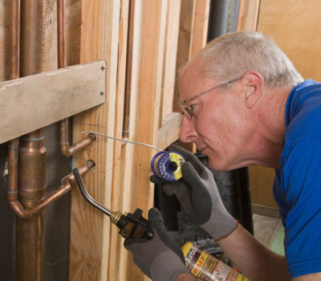
What Are The Conditions of U.S. EPA’s Audit Policy?
5. Correction and Remediation within 60 Calendar Days, in Most Cases, From the Date of Discovery.
Notes:
EPA can require correction within a shorter time period; facility can request more time, but must do so before the 60-day period has passed.

Slide 18
What Are The Conditions of U.S. EPA’s Audit Policy?
6. Agree to Take Steps to Prevent Recurrence of the Violation.

Slide 19
What Are The Conditions of U.S. EPA’s Audit Policy?
7. Repeat violations are ineligible (i.e., the specific (or closely related) violations occurred at same facility within past 3 years or occurred as a part of a pattern at multiple facilities owned or operated by the same entity within past 5 years).
Notes:
For purposes of this condition, “violation” means noncompliance with federal, state, or local environmental laws identified in a judicial or administrative order, complaint, notice of violation, conviction, or plea agreement; or any act or omission for which the company has previously received penalty mitigation.

Slide 20
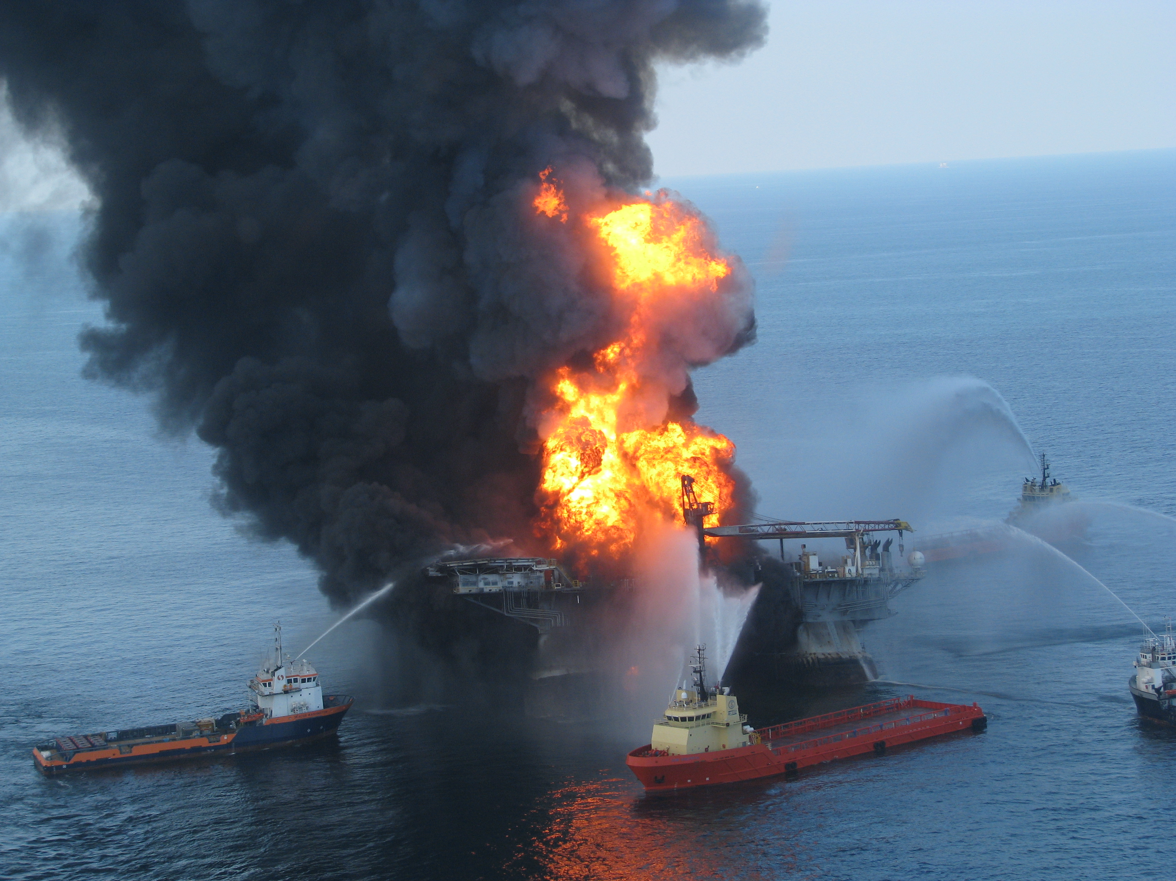
What Are The Conditions of U.S. EPA’s Audit Policy?
8. Violation must not be excluded from Policy (e.g., those that result in serious actual harm, present an imminent and substantial endangerment, or violate an administrative or judicial order or consent agreement).

Slide 21
What Are The Conditions of U.S. EPA’s Audit Policy?
9. Cooperation with EPA and Provide it with the Information it Needs to Determine Policy Applicability.

Slide 22
What Are The New Developments Concerning U.S. EPA’s Audit Policy?
“Interim Approach to Applying the Audit Policy to New Owners” (73 Federal Register 44,991):
Tailored Audit Policy incentives for new owners that want to make a “clean start” at their recently acquired facilities by addressing environmental noncompliance that began prior to acquisition.
Notes:
Definition of New Owner: So that only appropriate new owners can benefit from the tailored incentives, an eligible new owner must certify that: Prior to the transaction, it was not responsible for environmental compliance at the facility which is the subject of the disclosure, did not cause the violations being disclosed and could not have prevented their occurrence;
The violation which is the subject of the disclosure originated with the prior owner; and
Prior to the transaction, neither the buyer nor the seller had the largest ownership share of the other entity, and they did not have a common corporate parent.
Penalty Mitigation: Applies to new owners that, within 9 months of the transaction closing:
Promptly disclose violations to EPA, or
Enter into an audit agreement with EPA, and
Meet all the Conditions of the Audit Policy, as modified for new owners
No penalties will be assessed against the new owner for the period before the date of acquisition;
Penalties for economic benefit associated with avoided operation and maintenance costs will be assessed against the new owner, but only from the date of acquisition; and
No penalties for economic benefit associated with delayed capital expenditures or with unfair competitive advantage will be assessed against the new owner if the violations are corrected in accordance with the Audit Policy (i.e., within 60 days of discovery or another reasonable timeframe to which EPA has agreed).

Slide 23
What Are The New Developments Concerning U.S. EPA’s Audit Policy?
eDisclosure: EPA’s Electronic Audit Policy Self-Disclosure System
Can be used by facilities nationwide to disclose violations of the Emergency Planning and Community Right-to-Know Act (EPCRA)
Can be used by facilities in Region 6 states (Arkansas, Louisiana, New Mexico, Oklahoma, and Texas) to disclose violations of other environmental laws.

Slide 24
How can businesses take advantage of Illinois’ Environmental Audit Law?

Slide 25
What Is Illinois’ Environmental Audit Law?
Section 42(i) of the Illinois Environmental Protection Act (415 ILCS 5/42(i)).
Provides incentives for voluntary self-disclosure to the Illinois EPA of non-compliance.
Benefits of the Illinois Law mirror U.S. EPA’s Audit Policy

Slide 26
How Is Illinois’ Environmental Audit Law Different from U.S. EPA’s Audit Policy?
Non-compliance must be disclosed in writing within 30 days of discovery.
Non-compliance must be corrected and any environmental harm remediated in “a timely fashion.”

Slide 27
Questions
Dave Scriven-Young
Peckar & Abramson, P.C.
208 S. LaSalle Street, Suite 1356
Chicago, IL 60604
(312) 239-9722
dscriven-young@pecklaw.com
To sign up for free newsletter:
http://illinoisenvironmentallaw.com/subscribe/

